Slide 1
Chapter 4:
Networking and the Internet
Computer Science: An Overview
Twelfth Edition
by
J. Glenn Brookshear
Dennis Brylow

Slide 2
Story?
Once in a while there occurs a technological innovation of such importance that it forever changes a society and the way its people live, work, and communicate.
printing press by Johannes Gutenberg in the mid-fifteenth Century
Industrial Revolution in 18th and mid 19th Century
In our own century, we are certainly aware of the massive social changes, both good and bad, wrought by inventions like the telephone, automobile, television, and computer
One with the potential to make as great a change in our lives – computer networks
4-<number>

Slide 3

Tin Can Phone
Computer System Essentials : Networking

Slide 4
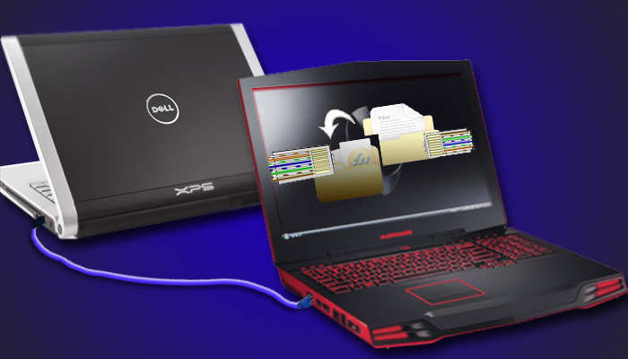
A Simple Network
Computer System Essentials : Networking

Slide 5
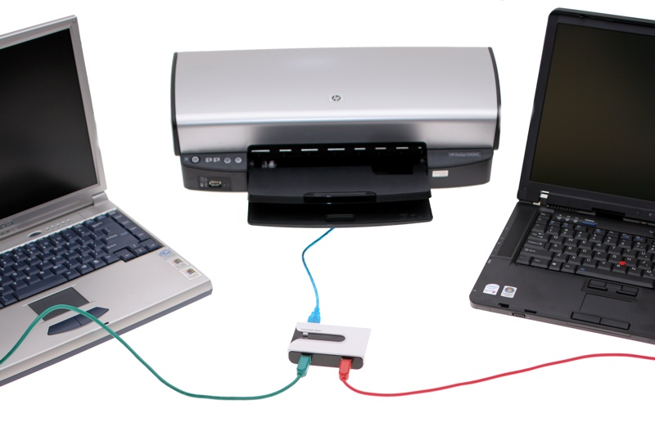
The Simple Network : Expansion
Computer System Essentials : Networking

Slide 6
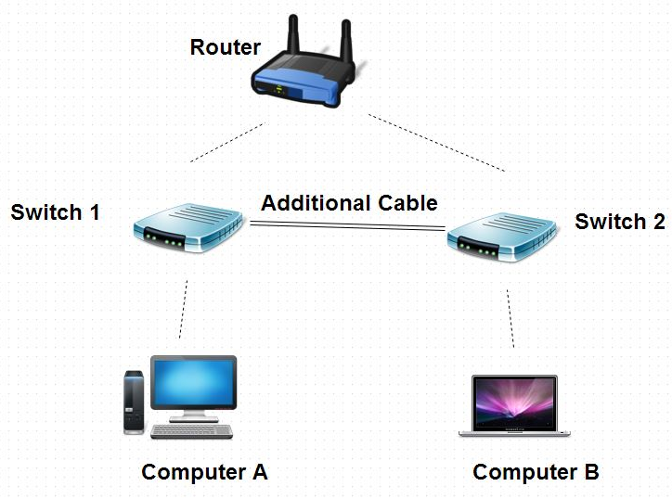
Interconnected Networks
Computer System Essentials : Networking

Slide 7
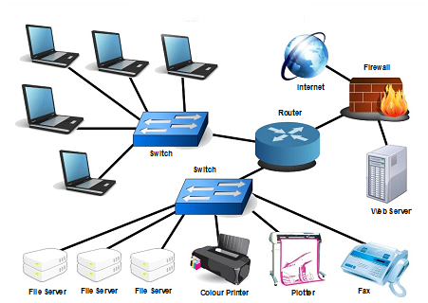
Interconnected Networks
Computer System Essentials : Networking

Slide 8
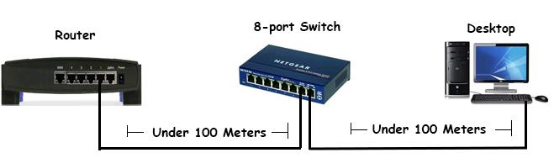
Networking Devices
Computer System Essentials : Networking

Slide 9
Objective of this topic
Significant area of computer science known as networking
the study of how computers can be linked together to share information and resources.
Study about the construction and operation of networks, applications of networks, and security issues.
Also learn about worldwide network of networks known as the Internet.
4-<number>

Slide 10
Communication Network: Definition
A communication network is a set of devices (often referred to as nodes) connected by communication links.
It provides a service:
  the transfer of information between users located at various geographical points.
Computer System Essentials : Networking

Slide 11
What is it?
A computer network is a set of independent computer systems connected by telecommunication links for the purpose of sharing information and resources.
The individual computers on the network are referred to as nodes, hosts, or end systems, and they range from PDAs (personal digital assistants) and tiny laptops to the massively parallel supercomputers
4-<number>

Slide 12
Basics of a computer network
Communication Links: networks vary widely in physical characteristics, error rate, and transmission speed
most common way to transmit data was via switched, dial-up telephone lines – analog medium
Computer – digital – binary signals – modem (modulator demodulator) – converts the analog to digital and vice versa
Bandwidth constraint – 1200 to 9600 bps … 56 kbps
Broadband – 256,000 bps
Digital Subscriber Line (DSL)
Cable Modem --
Ethernet – 100 mbps
Gigabit networking – 1 billion bps
4-<number>

Slide 13
Need to learn Networks:
Share information and resources among different computers -- link computer systems, called networks
Data can be transferred from machine to machine
Computer users can exchange messages and share resources
  such as printing capabilities, software packages, and data storage facilities which are scattered throughout the system
4-<number>

Slide 14
Chapter 4: Networking and the Internet
4.1 Network Fundamentals
4.2 The Internet
4-<number>

Slide 15
Network Classifications – Model 1
Scope: (LAN, MAN, WAN)
Local area network (LAN)
  LAN normally consists of a collection of computers in a single building or building complex
Metropolitan area (MAN)
  Network of intermediate size, such as one spanning a local community
Wide area network (WAN)
  Links machines over a greater distance—perhaps in neighboring cities or on opposite sides of the world.
4-<number>

Slide 16
Classification of networks – Model 2
Ownership: Closed versus open
  Open: network’s internal operation is based on designs that are in the public domain, Example: Internet. Anyone is free to use these standards without paying fees or signing license agreements.
  Closed (or propriety): owned and controlled by a particular entity such as an individual or a corporation.
Company such as Novell Inc. might develop proprietary systems for which it chooses to maintain ownership rights, allowing the company to draw income from selling or leasing these products.
4-<number>

Slide 17
Classification of networks – Model 3
Topology (configuration): refers to the pattern in which the machines are connected.
Bus (Ethernet) :
  machines are all connected to a common communication line called a bus
  popularized in the 1990s when it was implemented under a set of standards known as Ethernet, and Ethernet networks remain one of the most popular networking systems in use today
Star (Wireless networks with central Access Point)
  in which one machine serves as a central focal point to which all the others are connected
4-<number>

Slide 18
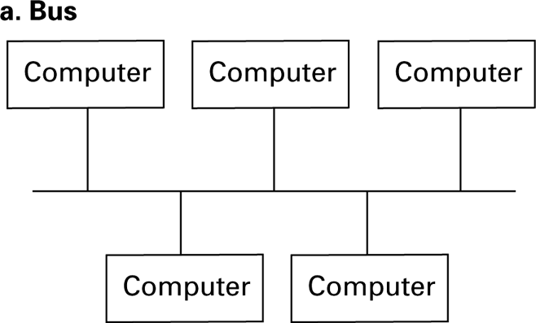
Figure 4.1 Network topologies
  All machines are connected to a common communication line called a bus
  popularized in the 1990s when it was implemented under a set of standards known as Ethernet, and Ethernet networks remain one of the most popular networking systems in use today
4-<number>

Slide 19
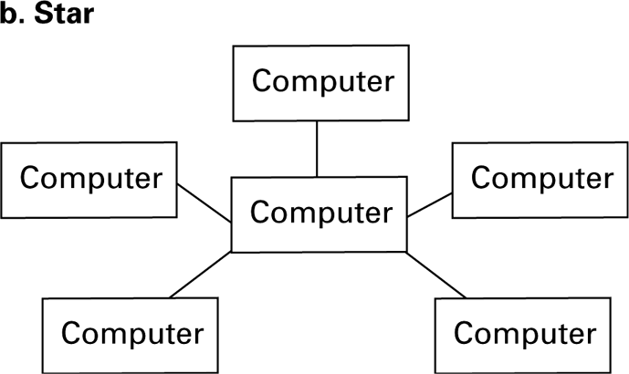
Figure 4.1 Network topologies (continued)
  Started in 1970s, evolved from the paradigm of a large central computer serving many users.
  As the simple terminals employed by these users grew into small computers themselves, a star network emerged.
  Star configuration is popular in wireless networks where communication is conducted by means of radio broadcast and the central machine, called the access point (AP), serves as a focal point around which all communication is coordinate
4-<number>

Slide 20
Bus vs. Star
Not always obvious by the physical arrangement of equipment
communicating directly with each other over a common bus (Bus Topology) vs. indirectly through an intermediary central machine (Star)
a bus network is created by running links from each computer to a central location where they are connected to a device called a hub
4-<number>

Slide 21
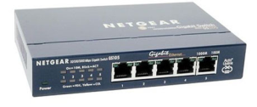
MESH
STAR
RING
BUS
Computer System Essentials : Networking

Slide 22
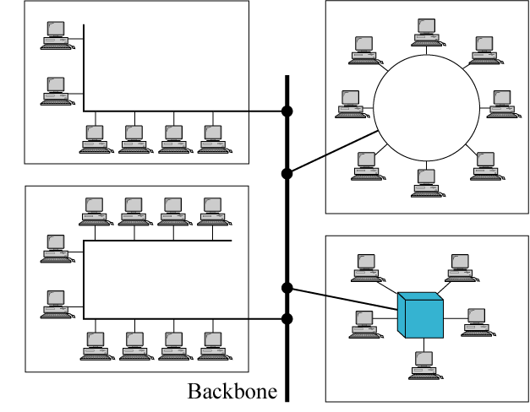
Hybrid Topology
Computer System Essentials : Networking

Slide 23
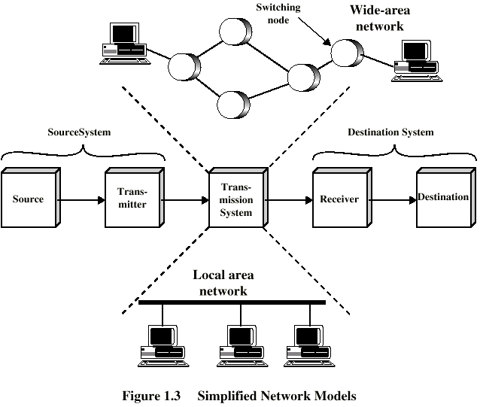
Simplified Communications Model - Diagram
Computer System Essentials : Networking

Slide 24
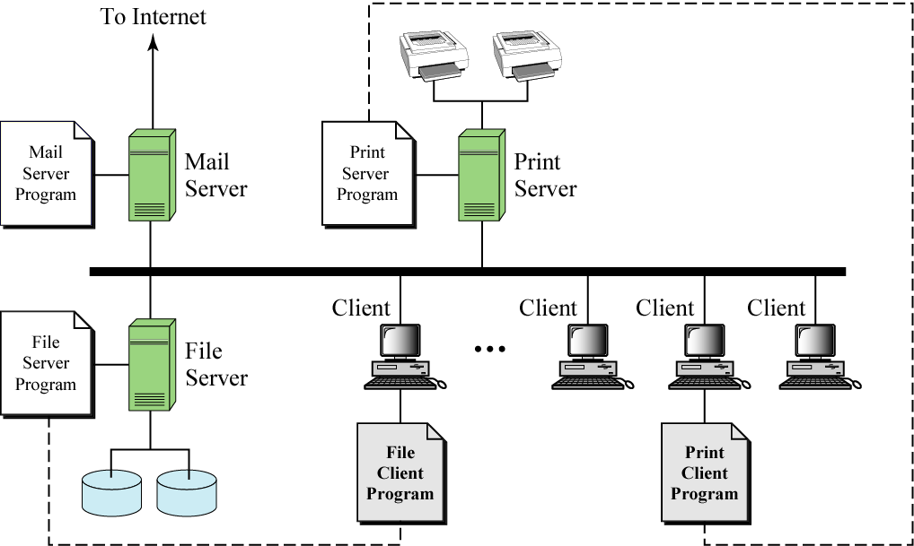
Client/Server Model
with Dedicated Servers
Computer System Essentials : Networking

Slide 25
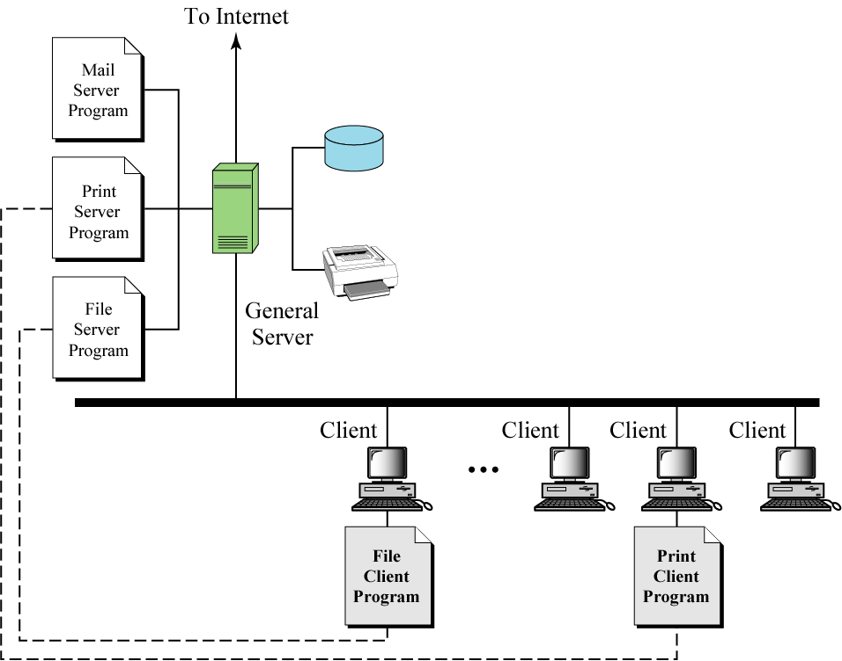
Client/Server Model
with a General Server
Computer System Essentials : Networking

Slide 26
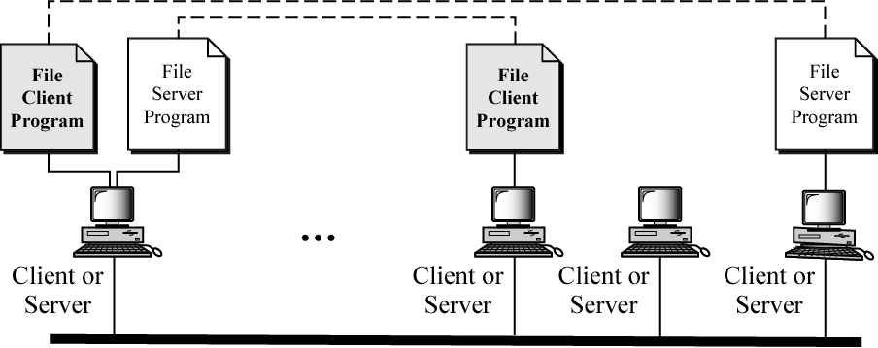
Peer-to-Peer Model
Computer System Essentials : Networking

Slide 27
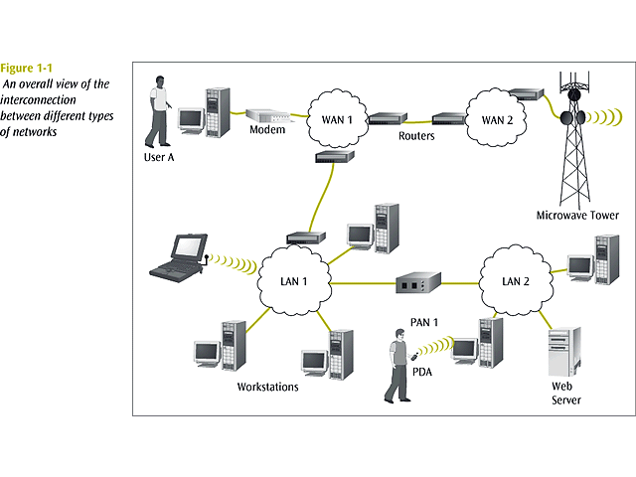
Different types of networks : Interconnection
Computer System Essentials : Networking

Slide 28
Basic Terms
internet/ Internet
IP Address
Domain Name
Packet
Protocol
Interface
Bandwidth and Throughput
Delay
firewalls
Computer System Essentials : Networking

Slide 29
internet
network of networks
Interconnection of networks
Computer System Essentials : Networking

Slide 30
Internet
The Internet is a collection of connected networks. In general, these networks are constructed and maintained by organizations called Internet Service Providers (ISPs).
Computer System Essentials : Networking

Slide 31
Internet
The Internet is at once a world-wide broadcasting capability, a mechanism for information dissemination, and a medium for collaboration and interaction between individuals and their computers without regard for geographic location.
Source: https://www.internetsociety.org/wp-content/uploads/2017/09/ISOC-History-of-the-Internet_1997.pdf
Computer System Essentials : Networking

Slide 32
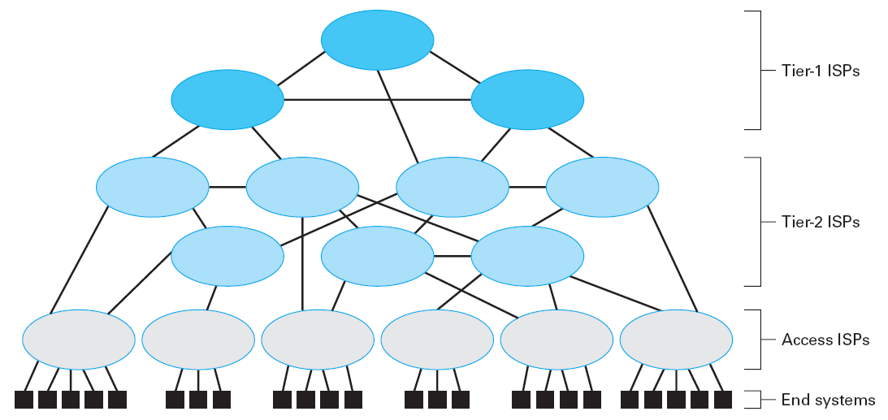
Internet Composition
high-speed, high-capacity, international WANs
backbone of the Internet
regional
Computer System Essentials : Networking

Slide 33
IP Address
IP refers to “Internet Protocol”
internet-wide addressing system that assigns a unique identifying address to each computer in Internet.
IP addresses are traditionally written in dotted decimal notation
IP Address Versions:
  IPv4 (version 4) each IP address was a pattern of 32 bits
  IPv6 (version 6) each IP address was a pattern of 128 bits
Computer System Essentials : Networking

Slide 34
What is IP Address
IP addresses are the numbers assigned to computer network interfaces.
Although we use names to refer to the things we seek on the Internet, such as www.example.org, computers translate these names into numerical addresses so they can send data to the right location. So when you send an email or visit a web site, your computer sends data packets to the IP address of the other end of the connection and receives packets destined for its own IP address.
Computer System Essentials : Networking

Slide 35
Need for IP Address
IP addresses are the numbers that enable our computers, servers, telephones, cameras, printers and sensors to communicate with each other.
Without IP addresses, our devices could not send data to each other without human intervention.
https://www.icann.org/en/system/files/files/ip-addresses-beginners-guide-04mar11-en.pdf
Computer System Essentials : Networking

Slide 36
IP Address : Distribution
IP addresses are distributed in a hierarchical system.
ICANN - Internet Corporation for Assigned Names & Numbers allocates IP address blocks to the five Regional Internet Registries
(RIRs) around the world.
The RIRs then allocate smaller IP address blocks to ISPs and other network operators.
ISPs and other Internet operators assign the addresses to the individual Internet connections
Computer System Essentials : Networking

Slide 37
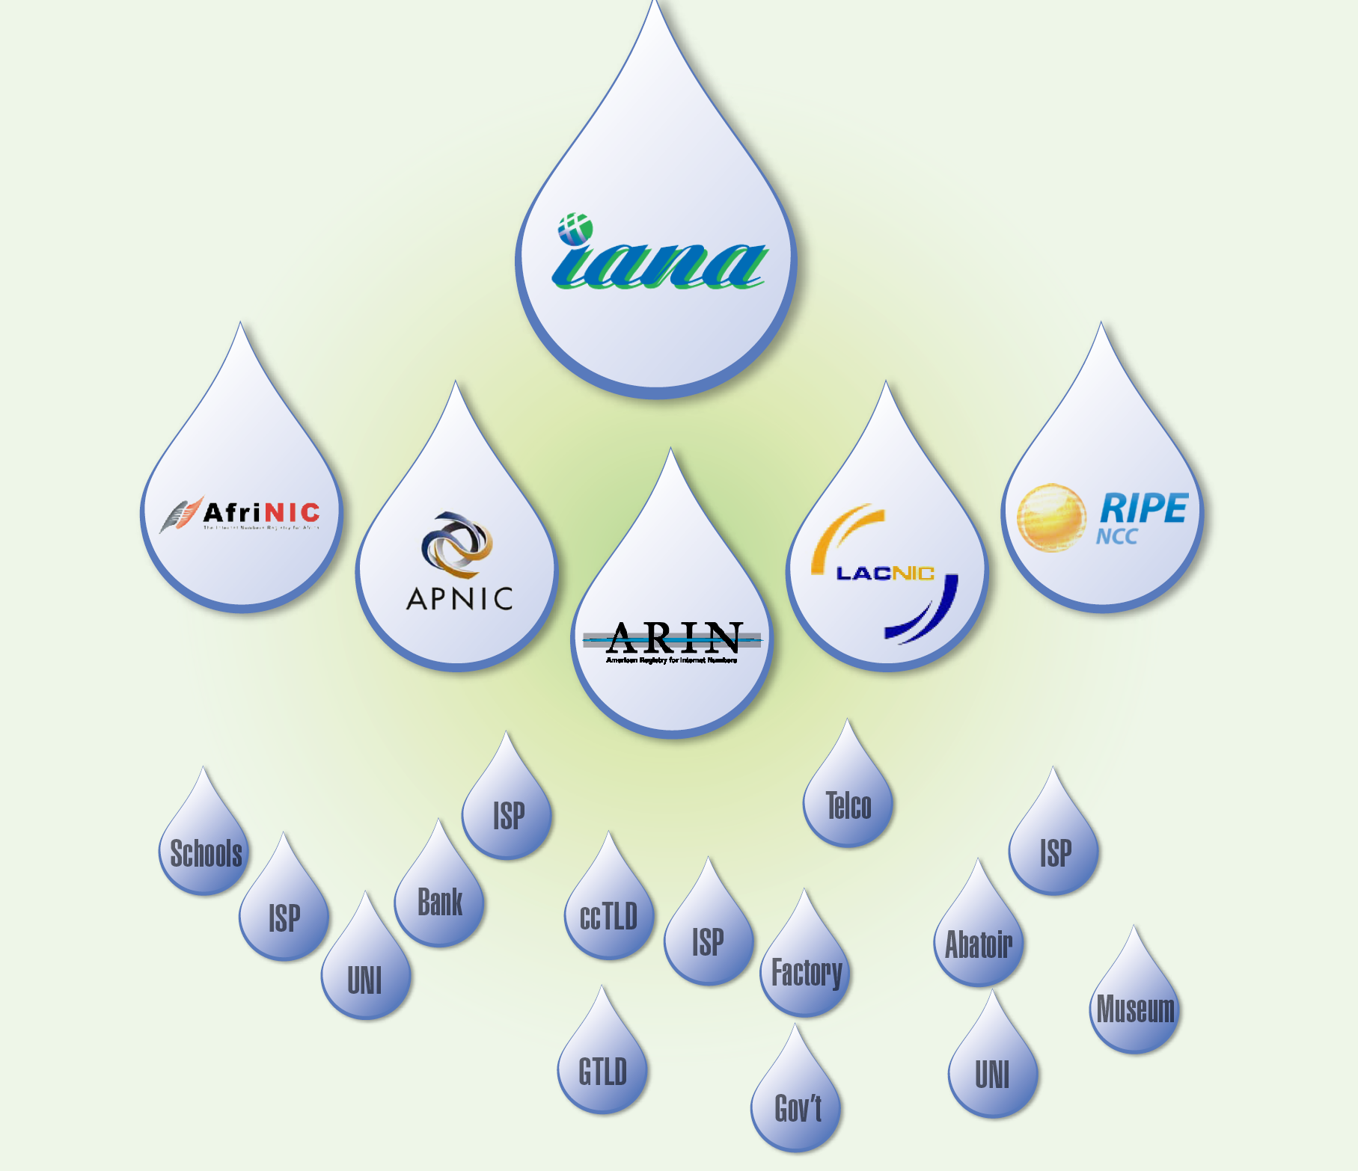
IP Address : Distribution
Computer System Essentials : Networking

Slide 38
Understand IP Addresses
An IP address is an address used in order to uniquely identify a device on an IP network.
The address is made up of 32 binary bits, which can be divisible into a network portion and host portion with the help of a subnet mask.
The 32 binary bits are broken into four octets (1 octet = 8 bits).
Each octet is converted to decimal and separated by a period (dot).
For this reason, an IP address is said to be expressed in dotted decimal format (for example, 172.16.81.100).
The value in each octet ranges from 0 to 255 decimal, or 00000000 - 11111111 binary.
4-<number>

Slide 39
How binary octets convert to decimal:
The right most bit, or least significant bit (LSB), of an octet holds a value of 2⁰.
The bit just to the left of that holds a value of 2¹.
This continues until the left-most bit, or most significant bit, which holds a value of 2⁷.
So if all binary bits are a one, the decimal equivalent would be 255 as shown here:
1 1 1 1 1 1 1 1
128 64 32 16 8 4 2 1 (128+64+32+16+8+4+2+1=255)
4-<number>

Slide 40
More on IP address
Here is a sample octet conversion when not all of the bits are set to 1.
0 1 0 0 0 0 0 1 0 64 0 0 0 0 0 1 (0+64+0+0+0+0+0+1=65)
And this sample shows an IP address represented in both binary and decimal.
10. 1. 23. 19 (decimal) 00001010.00000001.00010111.00010011 (binary)
4-<number>

Slide 41
IP address .. What it means
These octets are broken down to provide an addressing scheme that can accommodate large and small networks.
There are five different classes of networks, A to E.
We shall focus on classes A to C, since classes D and E are reserved and discussion of them is beyond the scope of this course.
4-<number>

Slide 42
Given an IP address, its class can be determined from the three high-order bits (the three left-most bits in the first octet).
Figure shows the significance in the three high order bits and the range of addresses that fall into each class. For informational purposes, Class D and Class E addresses are also shown.
4-<number>

Slide 43
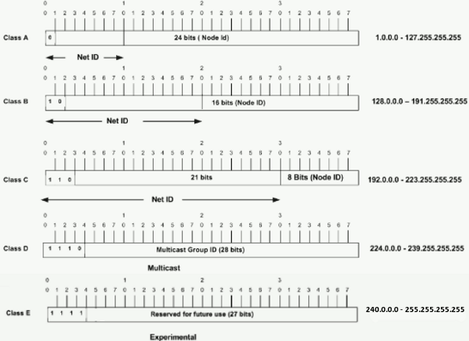
4-<number>

Slide 44
Class A - Address
In a Class A address, the first octet is the network portion, so the Class A example in Figure has a major network address of 1.0.0.0 to 127.255.255.255.
Octets 2, 3, and 4 (the next 24 bits) are for the network manager to divide into subnets and hosts as he/she sees fit.
Class A addresses are used for networks that have more than 65,536 hosts (actually, up to 16777214 hosts!).
4-<number>

Slide 45
Class B - Address
In a Class B address, the first two octets are the network portion, so the Class B example in Figure has a major network address of 128.0.0.0 to 191.255.255.255.
Octets 3 and 4 (16 bits) are for local subnets and hosts.
Class B addresses are used for networks that have between 256 and 65534 hosts.
4-<number>

Slide 46
Class C - Address
In a Class C address, the first three octets are the network portion.
The Class C example in Figure has a major network address of 192.0.0.0 to 223.255.255.255.
Octet 4 (8 bits) is for local subnets and hosts - perfect for networks with less than 254 hosts.
4-<number>

Slide 47
Domain Name
Domain can be thought of as a “region” of the Internet operated by a single authority such as a university, club, company, or government agency.
The domain is assigned a mnemonic domain name, which is unique among all the domain names throughout the Internet. Domain names are often descriptive of the organization registering the domain, which enhances their utility for humans.
Computer System Essentials : Networking

Slide 48
Domain Name
www.google.com
Sub-Domain name
Domain name
Top-level domain
www.amrita.edu
Computer System Essentials : Networking

Slide 49
Domain Name System (DNS)
Structured Naming
Internet Naming Service: DNS
Domain Name System (DNS) is a hierarchical and decentralized naming system for computers, services, or other resources connected to the Internet or a private network.
It associates various information with domain names assigned to each of the participating entities.
4-<number>

Slide 50
DNS History (1)
Advanced Research Projects Agency Network (ARPANET) was the world's first operational packet switching network, the first network to implement TCP/IP
ARPANET utilized a central file HOSTS.TXT
  Contains names to addresses mapping
  Maintained by SRI’s NIC (Stanford-Research-Institute: Network-Information-Center)
Administrators email changes to NIC
  NIC updates HOSTS.TXT periodically
Administrators FTP (download) HOSTS.TXT
Notes:
Advanced Research Projects Agency Network (ARPANET) was the world's first operational packet switching network, the first network to implement TCP/IP

Slide 51
DNS History (2)
As the system grew, HOSTS.TXT had problems with:
  Scalability (traffic and load)
  Name collisions
  Consistency
In 1984, Paul Mockapetris released the first version (RFCs 882 and 883, superseded by 1034 and 1035 …)
Notes:
RFC: Request for Comments
RFC 882 - Domain names: Concepts and facilities

Slide 52
The DNS is…
The “Domain Name System”
What Internet users use to reference anything by name on the Internet
The mechanism by which Internet software translates names to attributes such as addresses

Slide 53
The DNS is also…
A globally distributed, scalable, reliable database
Comprised of three components
  A “name space”
  Servers making that name space available
  Resolvers (clients) which query the servers about the name space

Slide 54
DNS as a Lookup Mechanism
Users generally prefer names to numbers
Computers prefer numbers to names
DNS provides the mapping between the two
  I have “x”, give me “y”

Slide 55
DNS as a Database
Keys to the database are “domain names”
  www.foo.com, 18.in-addr.arpa, 6.4.e164.arpa
Over 200,000,000 domain names stored
Each domain name contains one or more attributes
  Known as “resource records”
Each attribute individually retrievable

Slide 56
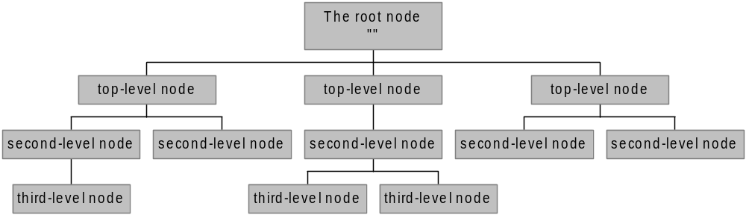
The Name Space
The name space is the structure of the DNS database
  An inverted tree with the root node at the top
Each node has a label
  The root node has a null label, written as “”

Slide 57
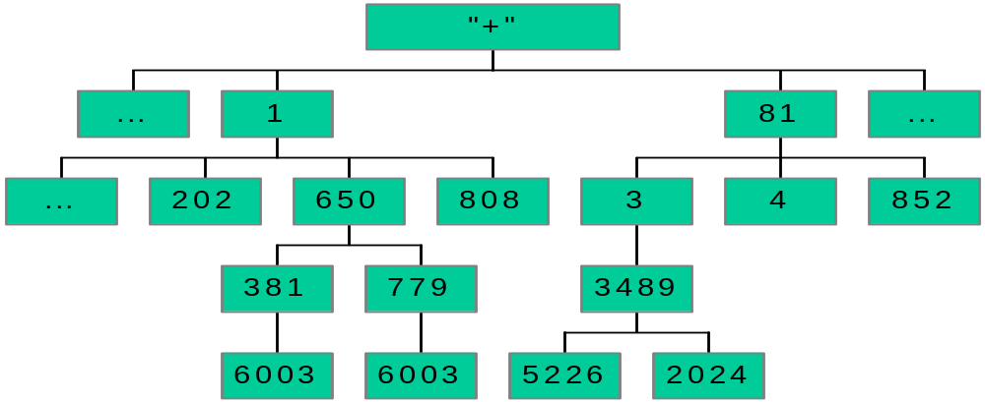
An Analogy – E.164
Root node maintained by the ITU - International Telecommunication Union (call it “+”)
Top level nodes = country codes (1, 81, etc)
Second level nodes = regional codes (1-402, 81-3, etc.)
Notes:
ITU: International Telecommunication Union
1: US/CA
81: JP

Slide 58
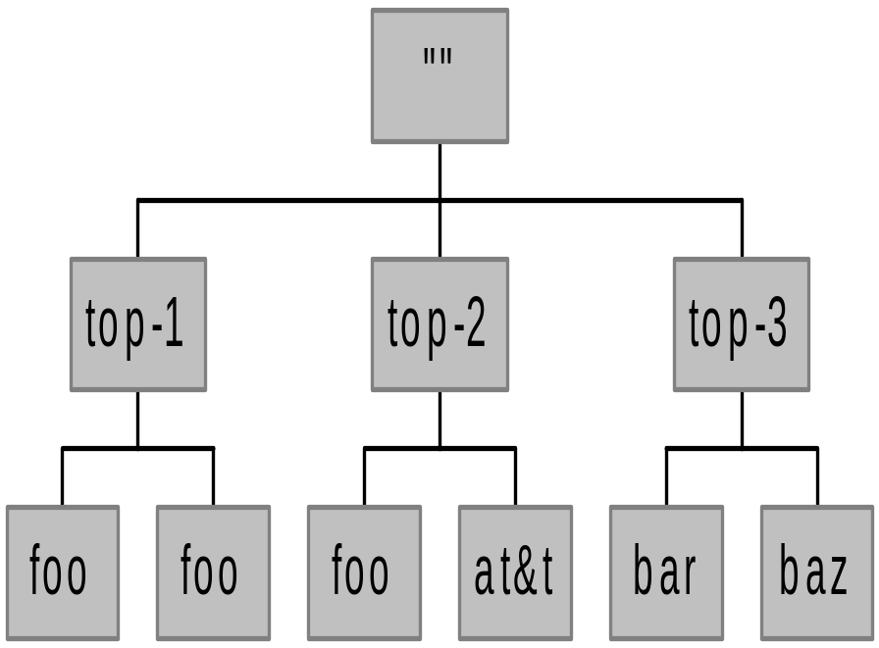
Labels
Each node in the tree must have a label
  A string of up to 63 bytes
  RFCs 852 and 1123 define legal characters for “hostnames”
    A-Z, 0-9, and “-” only with a-z and A-Z treated as the same
Sibling nodes must have unique labels
The null label is reserved for the root node

Slide 59
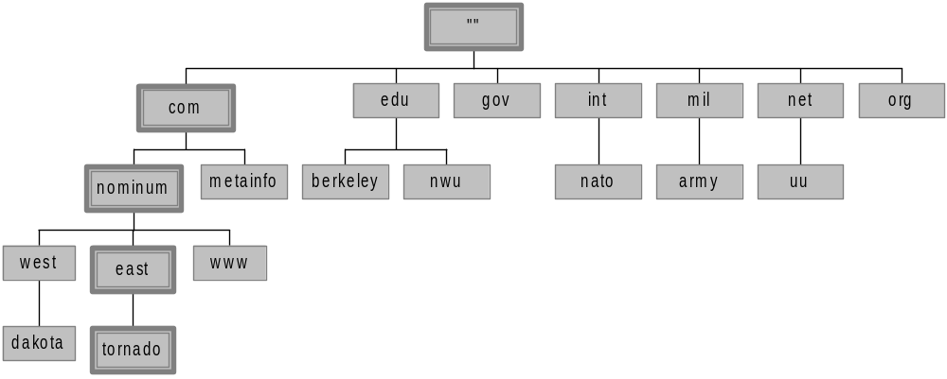
Domain Names
A domain name is the sequence of labels from a node to the root, separated by dots (“.”s), read left to right
  The name space has a maximum depth of 127 levels
  Domain names are limited to 255 characters in length
A node’s domain name identifies its position in the name space

Slide 60



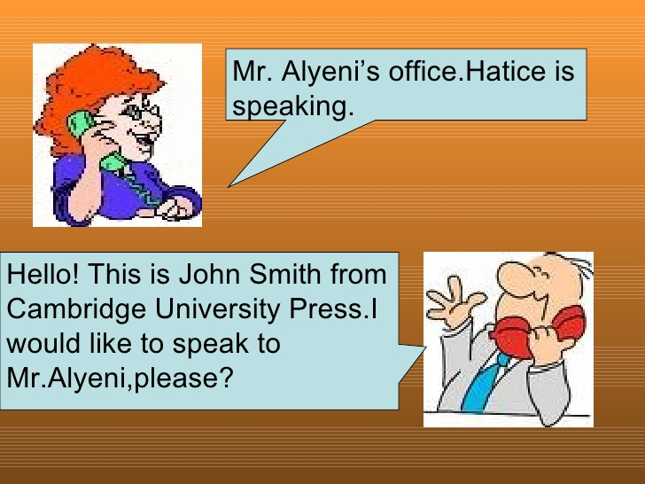
Communication :
Transfer of Information
Postal Network
Transport Network
Telephone Network
Computer System Essentials : Networking

Slide 61


Packet
Computer System Essentials : Networking

Slide 62
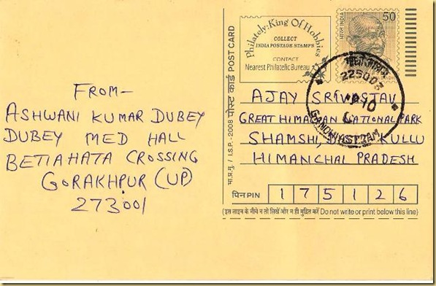
Packet :Sending and Receiving Information
P1
P1
Src: A
Dest: C
P1
P1
Src: B
Dest: C
Computer System Essentials : Networking

Slide 63
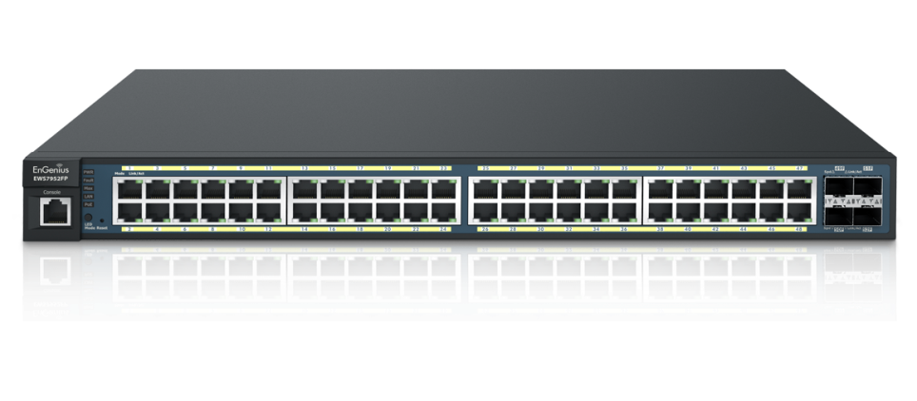
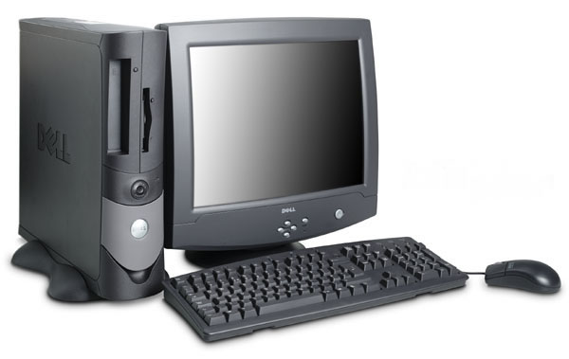
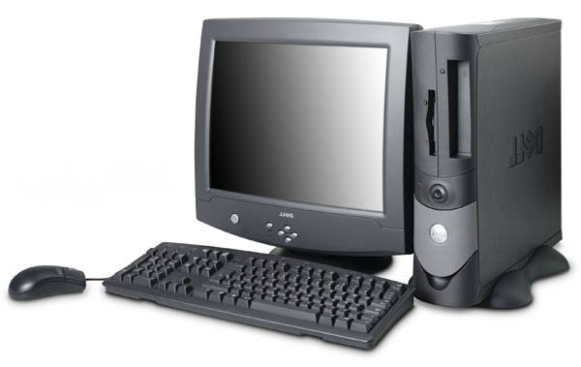
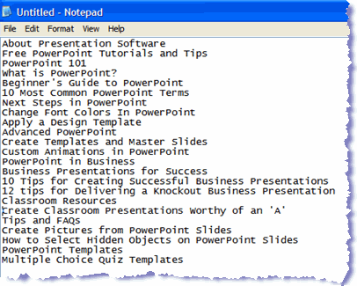
Transfer of file : Network Perspective
P6
P5
P4
P3
P4
P3
P2
P2
P1
P1
Computer A
Computer C
Computer B
Computer System Essentials : Networking

Slide 64
Transfer of file : Network Perspective
P6
P5
P4
P3
P2
P1
P4
P3
P2
P1
Computer A
Computer C
Computer B
Computer System Essentials : Networking

Slide 65
Protocol
A protocol is a set of rules that govern data communications. It represents an agreement between the communicating devices/parties.
Without a protocol, two devices may be connected but not communicating, just as a person speaking French cannot be understood by a person who speaks only Japanese.
Computer System Essentials : Networking

Slide 66


Human Protocol
Hi
Sir
Hi
yes
What is the time now ?
Can you tell me the time ?
2:00
2:00 pm

Slide 67

Network Protocol
TCP connection
Req.
TCP connection
response
Get http://google.com
Google
webpage
*TCP – Transmission Control Protocol
HTTP – Hyper Text Transfer Protocol

Slide 68
Protocols
Protocols are rules (standards) by which activities are conducted.
Bus topology uses: CSMA/CD
  Carrier Sense, Multiple Access with Collision Detection
  Used in Ethernet, provides right to introduce new message
Star topology uses: CSMA/ CA
  Carrier Sense, Multiple Access with Collision Avoidance
  Used in WiFi
  Hidden terminal problem
4-<number>

Slide 69
Bus: CSMA/CD
Each machine monitors all the messages but keeps only those addressed to itself.
To transmit a message, a machine waits until the bus is silent, and at this time it begins transmitting while continuing to monitor the bus.
If another machine also begins transmitting, both machines detect the clash and pause for a brief, independently random period of time before trying to transmit again.
4-<number>

Slide 70
Star: CSMA/CA
Many of which are standardized by IEEE within the protocols defined in IEEE 802.11 and commonly referred to as WiFi.
We emphasize that collision avoidance protocols are designed to avoid collisions and may not eliminate them completely.
When collisions do occur, messages must be retransmitted.
4-<number>

Slide 71
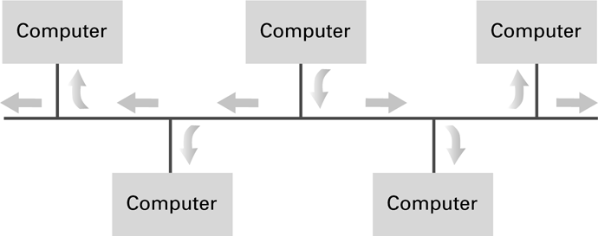
Figure 4.2 Communication over a bus network
4-<number>

Slide 72
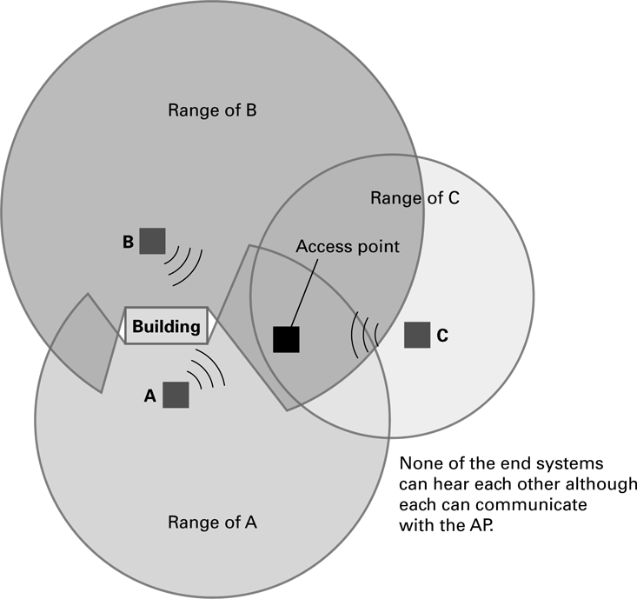
Figure 4.3 The hidden terminal problem
signals from the different machines are blocked from each other by objects or distance even though they can all communicate with the central AP
4-<number>

Slide 73
Data Rate and Bandwidth
Bandwidth is the capacity the channel i.e., number of bits per second that can be transmitted on the link.
Throughput is number bits transmitted(sent) per second
For example:
We might say that the bandwidth of an Wifi is 10 Mbps. But, actual transfer rate is 5Mbps
Computer System Essentials : Networking

Slide 74
Delay (Latency)
Delay is the total time a message takes to travel from one end of a network to the other.
For example, a message takes 24 ms to travel from one end of North America to the other.
Computer System Essentials : Networking

Slide 75
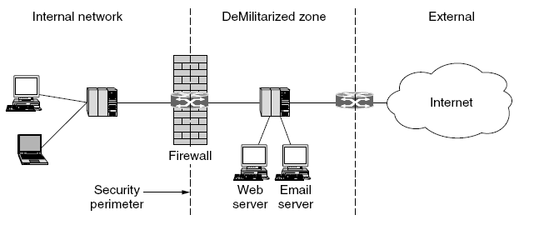
Firewall
Demilitarized Zone:
Part of the company network that lies outside of the security perimeter
The firewall acts as a packet filter. It inspects each and every incoming and outgoing packet. Packets meeting some criterion described in rules formulated by the network administrator are forwarded normally. Those that fail the test are dropped.
Computer System Essentials : Networking

Slide 76
Connecting Networks
Repeater: Extends a network
Bridge: Connects two compatible networks
Switch: Connects several compatible networks
Router: Connects two incompatible networks resulting in a network of networks called an internet
4-<number>

Slide 77
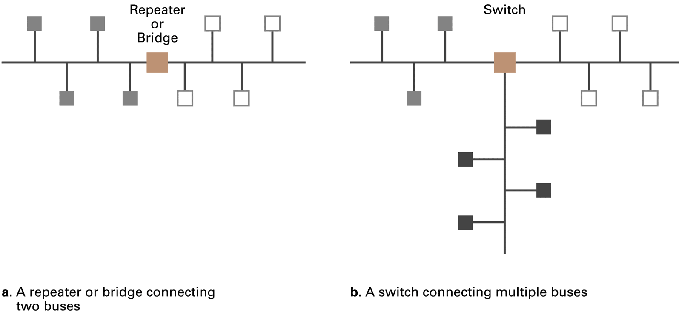
Figure 4.4 Building a large bus network from smaller ones
4-<number>

Slide 78
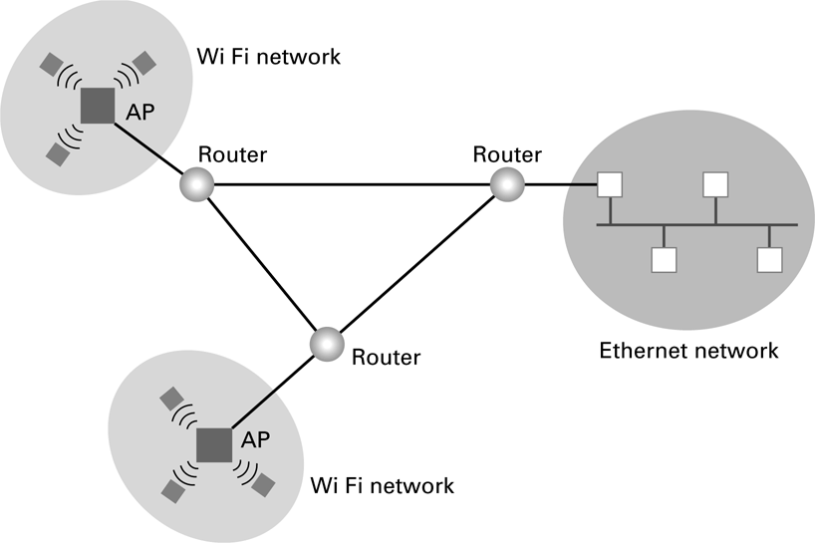
Figure 4.5 Routers connecting two WiFi networks and an Ethernet network to form an internet
4-<number>

Slide 79
Networking Models
Application layer
Application layer
Presentation layer
Session layer
Transport layer
Transport layer
Internet layer
Network layer
Data link layer
Data link layer
Physical layer
Physical layer
OSI Model
TCP/IP Model
Computer System Essentials : Networking

Slide 80
Distributed Systems
Systems with parts that run on different computers
  Cluster computing
  Grid computing
  Cloud computing
    Amazon’s Elastic Compute Cloud
    Google Drive
4-<number>

Slide 81
Early Internet Applications
Network News Transfer Protocol (NNTP)
File Transfer Protocol (FTP)
Telnet and SSH
Hypertext Transfer Protocol (HTTP)
Electronic Mail (email)
  Domain mail server collects incoming mail and transmits outing mail
  Mail server delivers collected incoming mail to clients via POP3 or IMAP
4-<number>

Slide 82
SMTP Simple Mail Transfer Protocol
220 mail.tardis.edu SMTP Sendmail Gallifrey-1.0; Fri, 23 Aug 2413 14:34:10
HELO mail.skaro.gov
250 mail.tardis.edu Hello mail.skaro.gov, pleased to meet you
MAIL From: dalek@skaro.gov
250 2.1.0 dalek@skaro.gov... Sender ok
RCPT To: doctor@tardis.edu
250 2.1.5 doctor@tardis.edu... Recipient ok
DATA
354 Enter mail, end with "." on a line by itself
Subject: Extermination.
EXTERMINATE!
Regards, Dalek
.
250 2.0.0 r7NJYAEl028071 Message accepted for delivery
QUIT
221 2.0.0 mail.tardis.edu closing connection
4-<number>

Slide 83
More Recent Applications
Voice Over IP (VoIP)
Internet Multimedia Streaming
  N-unicast
  Multicast
  On-demand streaming
  Content delivery networks (CDNs)
4-<number>

Slide 84
More of Computer Networks will be explored in later semesters
End of Course…
CSE101 – Computer Systems Essentials
4-<number>

